Slide 1


Arrays

Slide 2
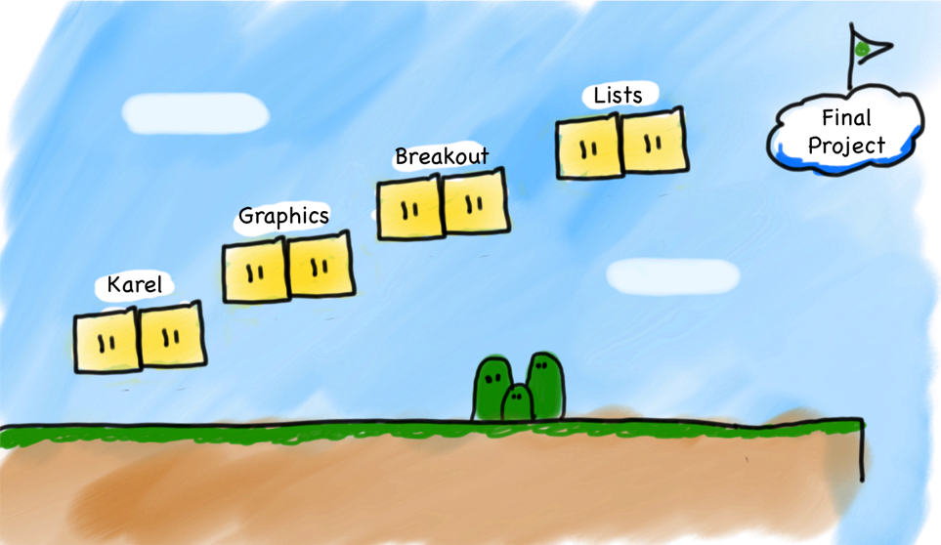
Where are we?

Slide 3

Learning Goals
Understand array data structures
Use arrays in a program

Slide 4
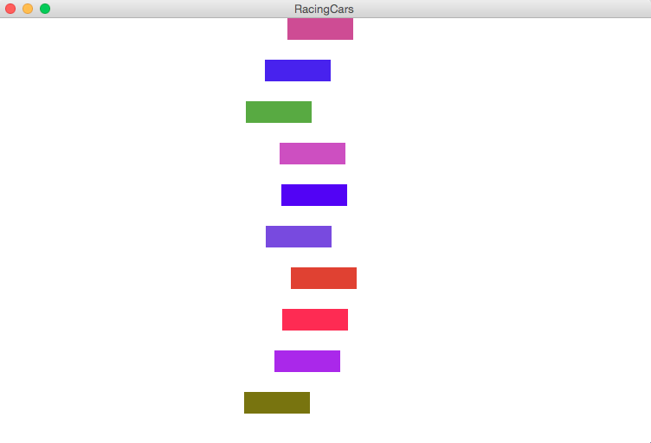
Racing Cars!
Notes:
Introduce the Game

Slide 5
What are Data Structures?
Data structures are variable types that can store data in interesting ways.

Slide 6
What are Arrays?
1 box = a variable
many connected boxes = an array

Slide 7
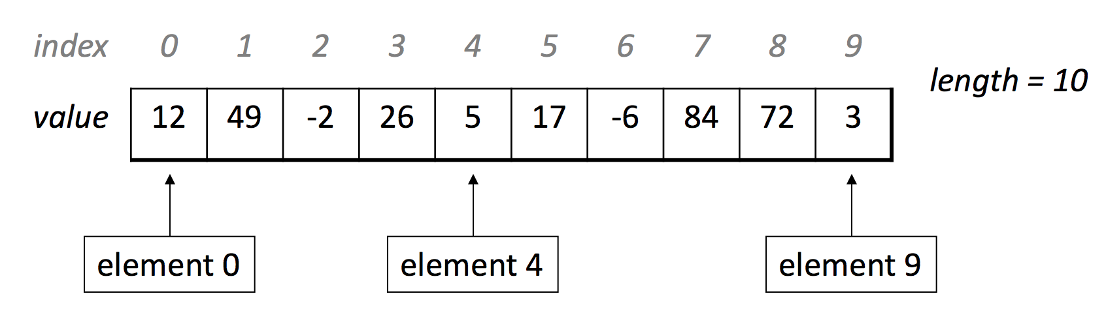
What are Arrays?
Arrays have elements that you can access using indices.
Notes:
Note: index starts at 0!!!!!!!
***this means the length is a number larger than the highest index**

Slide 8
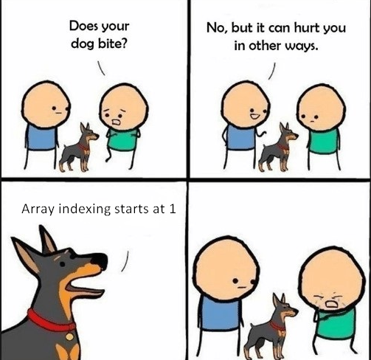
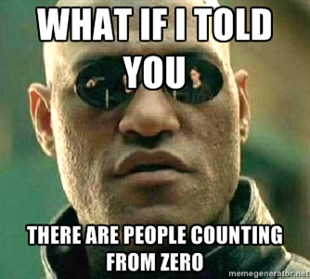

Slide 9
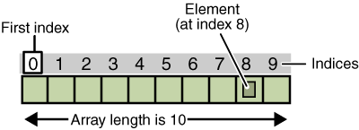
Arrays: Basic properties
1.
An array is ordered.(considering indices not the contents)
2.
An array is homogeneous.
Notes:
Explain homogeneous

Slide 10
Declaring an Array variable
type[] name = new type[n];
int[] intArray = new int[10];
intArray
0
0
0
0
0
0
0
0
0
0
0
1
2
3
4
5
6
7
8
9
Notes:
Note: Java automatically initializes elements to 0.
Note: arrays are objects

Slide 11
Array selection
You can, for example, select the initial element by writing
intArray[0]
Assigning a value to an element
intArray[9] = 42;
intArray
0
0
0
0
0
0
0
0
0
0
42
0
1
2
3
4
5
6
7
8
9

Slide 12
Cycling through array elements
Cycling through each of the array elements
for (int i = 0; i < array.length; i++) {
Operations involving the i^{th} element of the array
}
As an example, you can reset every element in intArray to -1 using the following for loop:
for (int i = 0; i < intArray.length; i++) {
intArray[i] = -1;
}

Slide 13
Initializing arrays
Java makes it easy to initialize the elements of an array as part of a declaration. The syntax is
type[] name = { elements };
For example, the following declaration initializes the variable powersOfTen to the values 10⁰, 10¹, 10², 10³, and 10⁴:
int[] powersOfTen = { 1, 10, 100, 1000, 10000 };
This declaration creates an integer array of length 5 and initializes the elements as specified.

Slide 14


Initializing arrays
In Java, an array’s length must be specified on creation and cannot be modified afterwards.
int[] powersOfTen = new int[];
int[] powersOfTen = new int[5];
int[] powersOfTen = { 1, 10, 100, 1000, 10000 };

Slide 15
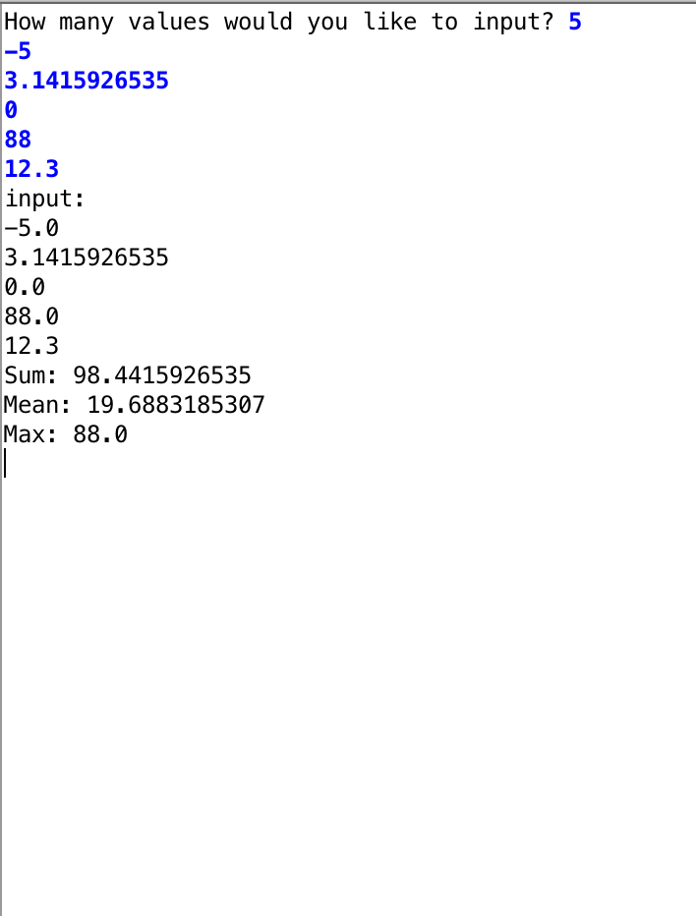
Exercise: Statistics!
Notes:
CODE ArrayExamples
Cmd + ‘+’ to zoom

Slide 16
Array Types
You can make an array of any other type!
int[] intArray = new int[10];
char[] charArray = new char[10];
Color[] colorArray = new Color[10];
GRect[] grectArray = new GRect[10];
int[][] arrayArray = new int[10][10];

Slide 17
An array of graphical objects
Notes:
Introduce the Game

Slide 18
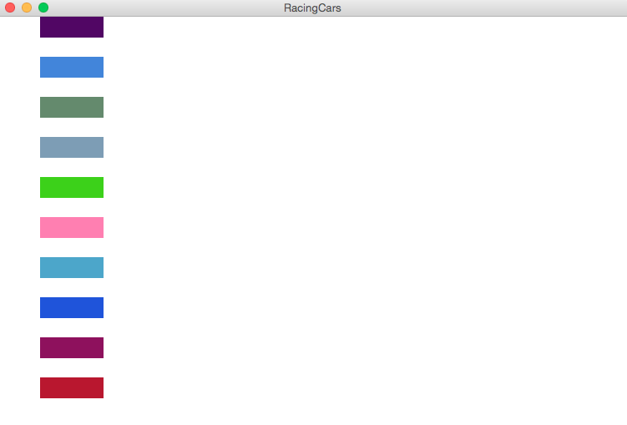
Creating an array of objects
private final int CAR_WIDTH=75;
private final int X_OFFSET=50;
private final int NUM_CARS=50;
public void run(){
double carHeight=getHeight()/(2*NUM_CARS);
GRect[] cars=new GRect[NUM_CARS];
for(int i=0;i<NUM_CARS;i++){
cars[i]=new GRect(CAR_WIDTH,carHeight);
cars[i].setColor(rgen.nextColor());
cars[i].setFilled(true);
add(cars[i],X_OFFSET,(2*i)*carHeight);
}
}

Slide 19
Animating an array of objects
Notes:
CODE
Day 5 -> RacingCars

Slide 20
Summary
An array is an ordered, homogeneous list of data.
Arrays can store both primitives (int, double, char, etc) and objects (GRect, GLine, etc)
Array indices start at 0.
An array’s length cannot be changed once it is created.

Slide 21
Extra: Array Challenges
Reversing
Sorting
2-D Arrays

